Slide 1


MathWorks presents: Simulink Onramp and Introduction to Mini Drone Simulation Design
By, Deepak Guru Ganesan
MATLAB Student Ambassador at Chalmers
Notes:
Good afternoon and thank you all for coming to this lecture.

Slide 2
Agenda
Who am I?
MathWorks
What is Simulink?
Overview
Tutorials and Demo
Introduction to the Mini Drone Competition
Cody Competition Winners
Kahoot Quiz!!
MATLAB Central community

Slide 3

Who am I?
MATLAB Student Ambassador @Chalmers.
MSc in Complex Adaptive Systems
Join the facebook group MATLAB@Chalmers http://tiny.cc/matlabchalmers
Join the Instagram page of MATLAB Chalmers https://instagram.com/matlab_chalmers?igshid=xw5gw0v1crv2
Any event suggestions? Email me: deepakg@student.chalmers.se

Slide 4
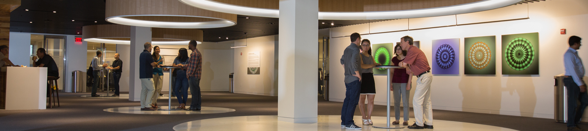


The leading developer of mathematical computing software for engineers and scientists.
Notes:
MathWorks is the leading developer of mathematical computing software
Engineers and scientists worldwide rely on our products to accelerate the pace of discovery, innovation, and development

Slide 5
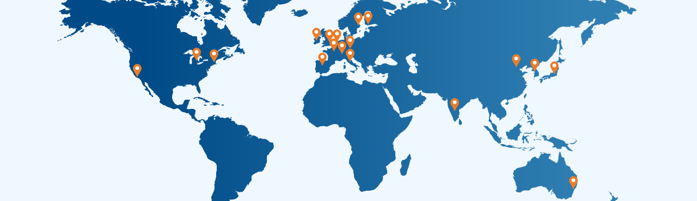





MathWorks Today
Headquarters
Natick, MA USA
Europe
France
Germany
Ireland
Italy
Netherlands
Spain
Sweden
Switzerland UK
Asia-Pacific
Australia
China
India
Japan
Korea
North America
United States
3 million+
users
4000+ staff
$950 million
Privately
held
in more than 180 countries
in 31 offices around the world
in 2020 revenues with 60% from outside the US
and profitable every year
Notes:
Over 3 million people in more than 180 countries use our products
MathWorks is a global company with over 4000 staff members in 31 offices
We’re profitable; our revenues last year exceeded $900 million, with 60% coming from outside the US

Slide 6


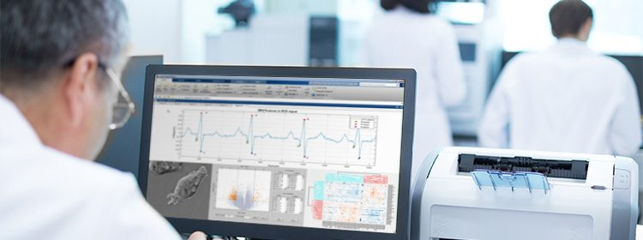

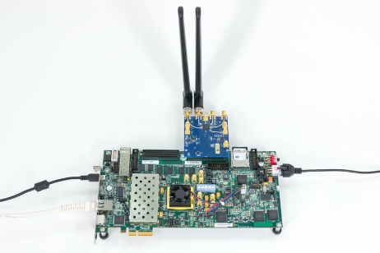



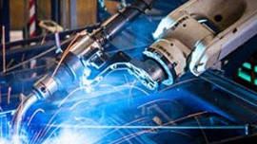
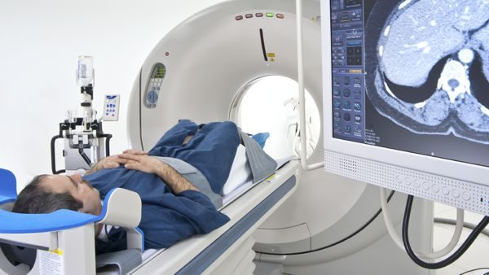

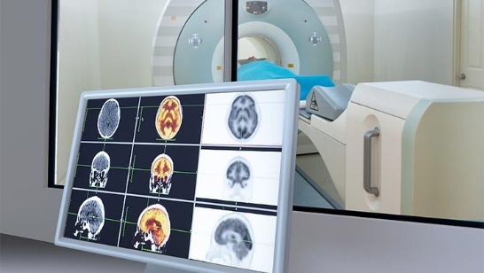
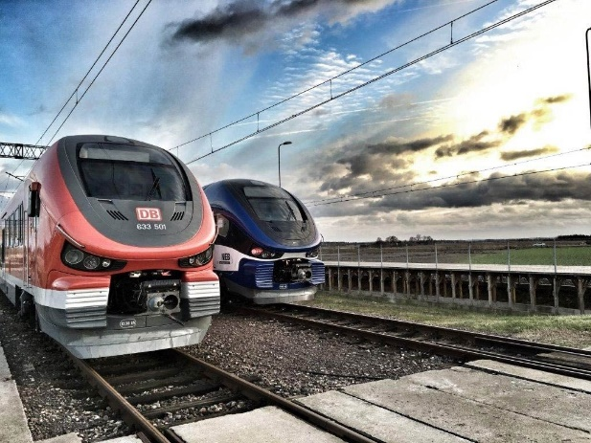

Our Customers / Key Industries
Aerospace and Defense | Automotive | Biological Sciences | Biotech and Pharmaceutical | Communications
Electronics | Energy Production | Financial Services | Industrial Machinery | Medical Devices
Metals, Materials, Mining | Neuroscience | Railway Systems | Semiconductors | Software and Internet
Notes:
All told, our software is used in over 20 industries, from aerospace and automotive, to biotech, energy production, financial services, medical devices, and railway systems.

Slide 7
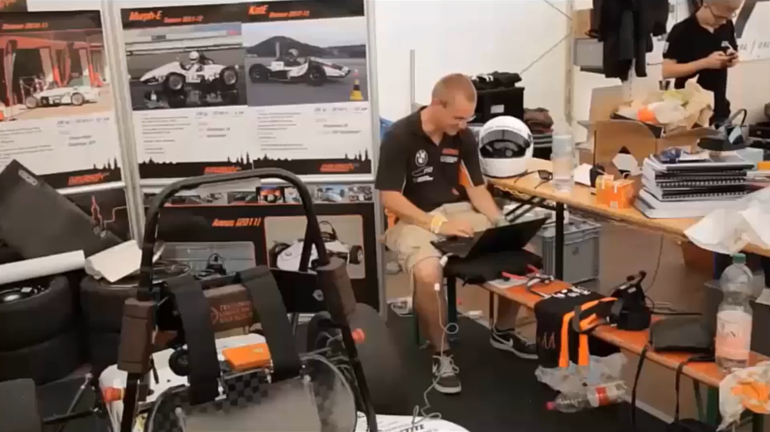

Education / Student Competitions
Sponsored 44 competitions and provided software to 2800 teams in 2020
Fields include automotive, aerospace, biotech, programming, and robotics
Notes:
We also support dozens of student competitions worldwide each year in all kinds of fields, including automotive, aerospace, and robotics
<CLICK TO PLAY VIDEO>
At the Formula Student Germany competition, over 100 teams use our products to simulate strategies, analyze performance, and implement controllers
RoboBoat challenges students to develop a boat that can autonomously navigate through a series of channel markers
And RoboCup is a global competition where students field teams of autonomous robots in simulated soccer matches

Slide 8
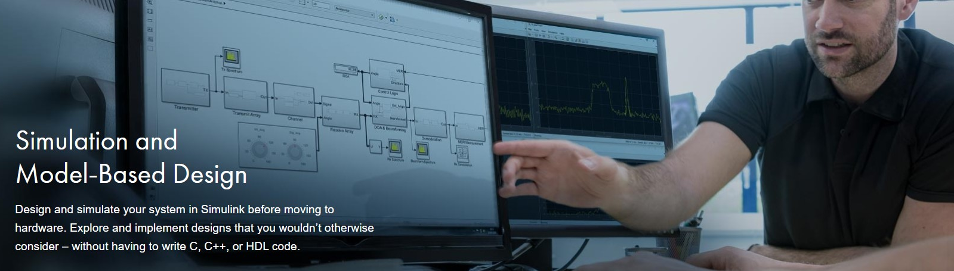
What is Simulink?
Notes:
Add on for MATLAB
Provides GUI and interactive interface for
Modelling, simulation and analyzing dynamic systems

Slide 9
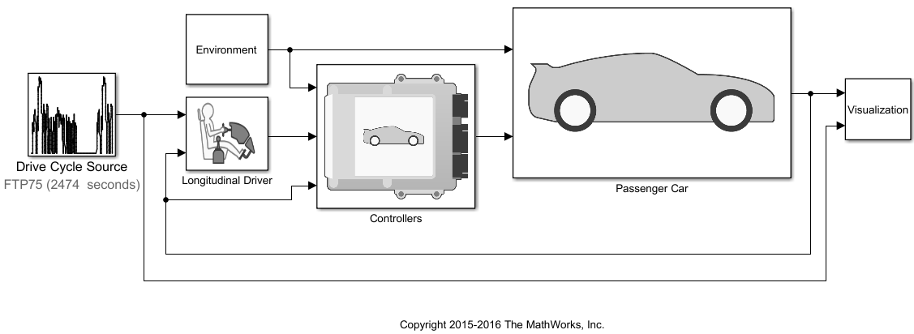

Simulink Overview
Model and simulate your system
Use one multi-domain environment
Model the system under test and the plant
Simulate closed-loop system behavior
Test early and often
Test your system under all conditions
Validate your design with real-time testing
Trace from requirements to design to code
Automatically generate code
Generate production-quality C and HDL code
Deploy directly to embedded processors or FPGA’s/ASIC’s
Notes:
Simulink is a multi-domain modeling and simulation environment tool that allows engineers and scientists to design and test systems using model based design.
With Simulink you can design and simulate your system in Simulink before moving to hardware without having to write C, C++, or HDL code.
The video being played is an example of the powers of Simulink. By building a model and controller of a car we can see how it drives on an example course without having to crash any cars. P.S. the car/track is visualized in Unreal Engine which Simulink is able to integrate with.

Slide 10
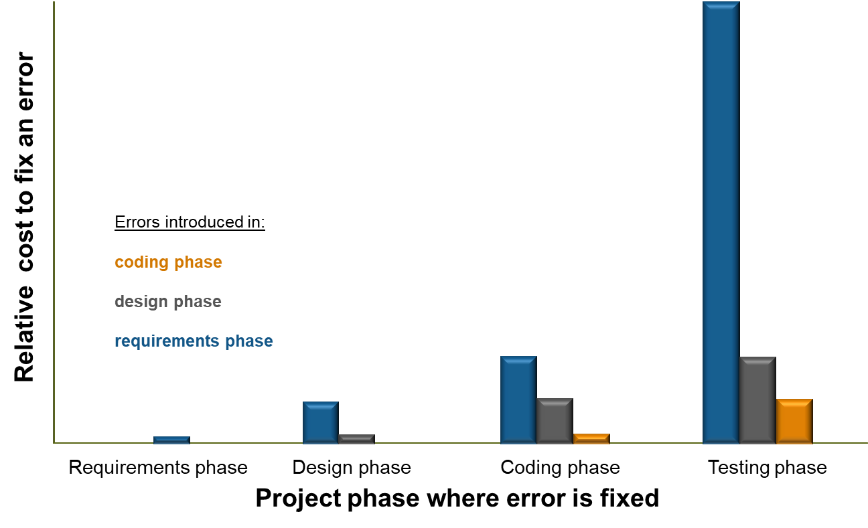
Why use Simulink?
Requirement errors are the most expensive to fix during the testing stages of a project
With Simulink you can reduce the time spent in the testing phase
Visualize, interact with, and test your system all in Simulink to find errors early
Source: Return on Investment for Independent Verification & Validation, NASA, 2004.
Notes:
So why do we need to find errors early, why did people list it as an important challenge?
Here is a study by NASA, that answers these questions. The x-axis shows the phase where the error is found and fixed, and the y-axis shows the relative cost to fix the error.
Bar color corresponds to the project phase where the error was introduced.
So, finding errors early means we can develop our products cheaper and quicker, and that is why it is so important.
[Note to presenter: NASA study can be downloaded directly from http://sarpresults.ivv.nasa.gov/DownloadFile/24/10/Direct%20ROI%20of%20IV&V%20ATS2003%20presentation.ppt
The saved version of the report (powerpoint file) is also available on the ECL).]

Slide 11
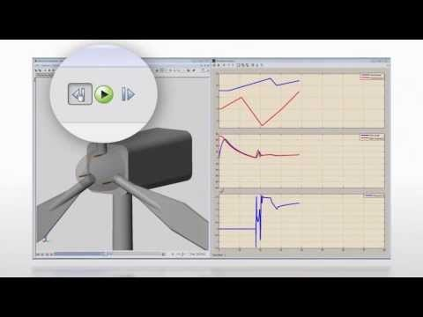
Notes:
https://www.youtube.com/watch?v=NiutwnUP-aI&t=1s

Slide 12
How does Simulink look like?

Slide 13
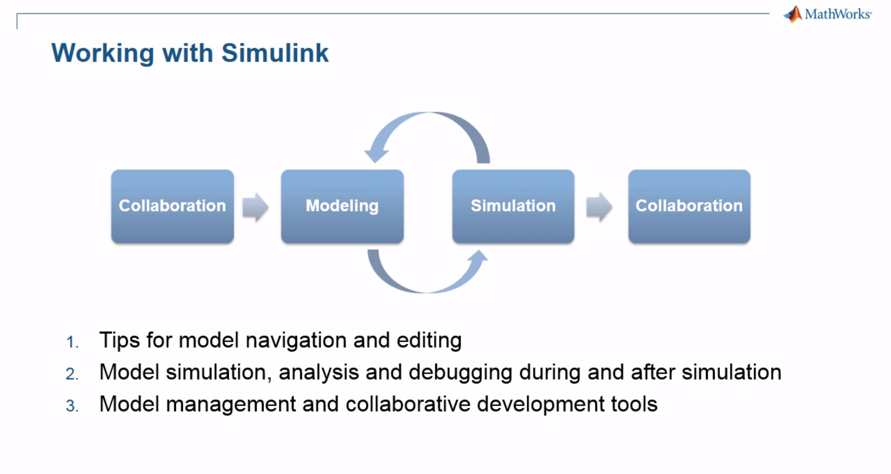
Notes:
Ok, how can we define the whole Simulink in the block model. You can collaborate and do the system modeling with your teammates. Then you can do system analysis, debug and if you want to change anything, you can again start the modeling and that will be a repetitive process until you achieve a satisfactory model. Then you can use version control system to again share your project and collaborate with multiple people.

Slide 14
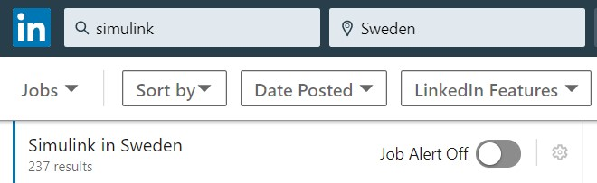
Why do you need Simulink?
One of the most sought-after skill for an engineer.
Rapid prototyping for your project.
Develop, interface between different hardware.
Wide range of applications.

Slide 15
Introduction Tutorial and Demos
Simulink Tutorial
Lane departure warning – vipldws
Bar code recognition - vipbarcoderecognition

Slide 16
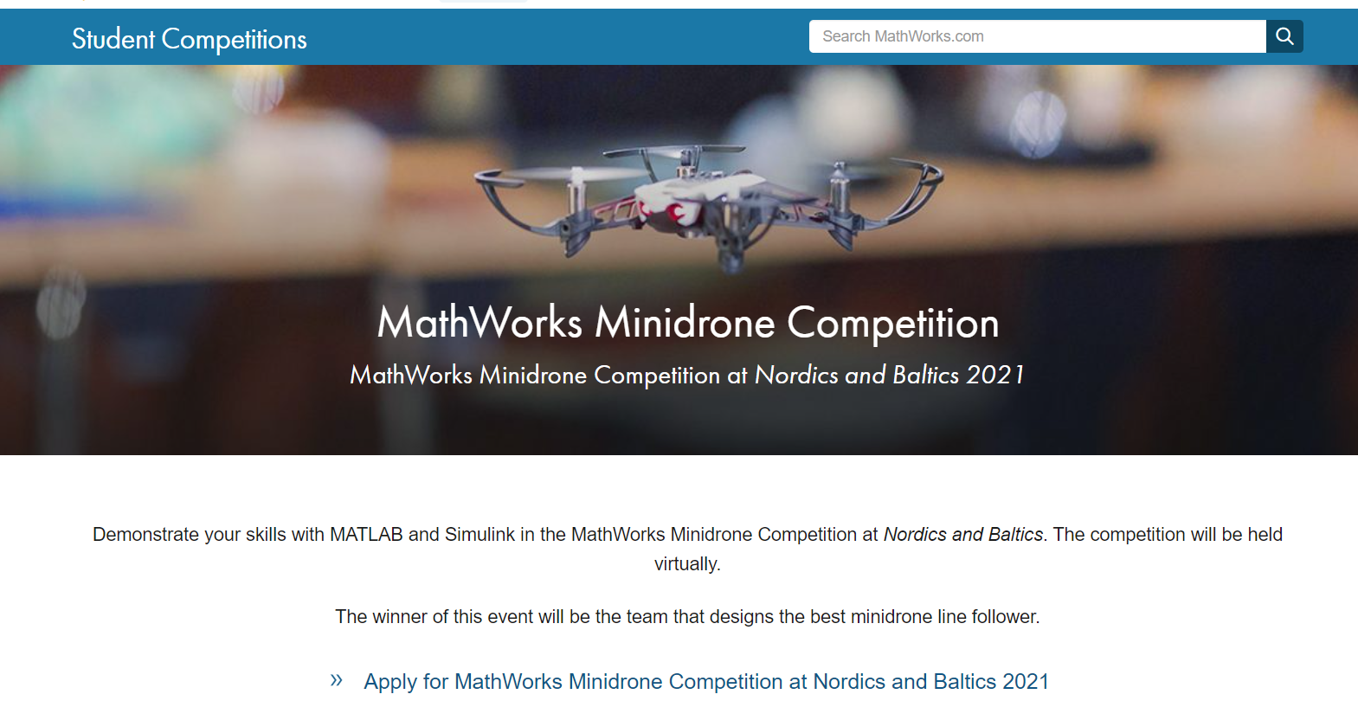
Mathworks Minidrone Competition 2021

Slide 17
Competition Overview
The competition consists of two rounds:
Round 1
Simulation Round Teams will work virtually on designing a Minidrone line follower algorithm. Teams will need to use their modeling skills to refine a Simulink model.
Round 2
Simulation and Hardware Deployment Round or
Virtual Round

Slide 18
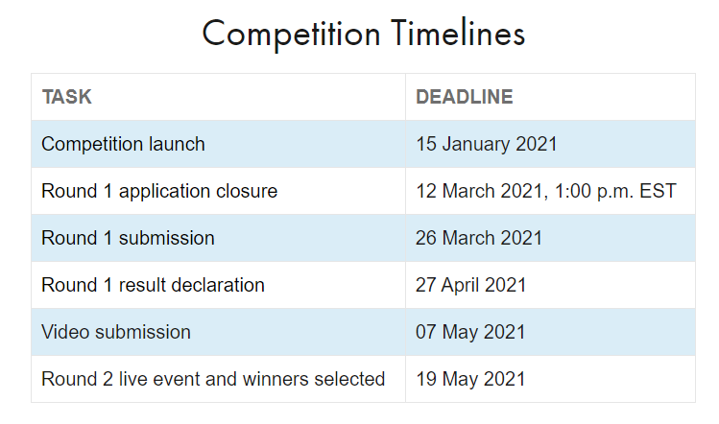
MathWorks Minidrone Simulation Competition Nordics and Baltics 2021

Slide 19
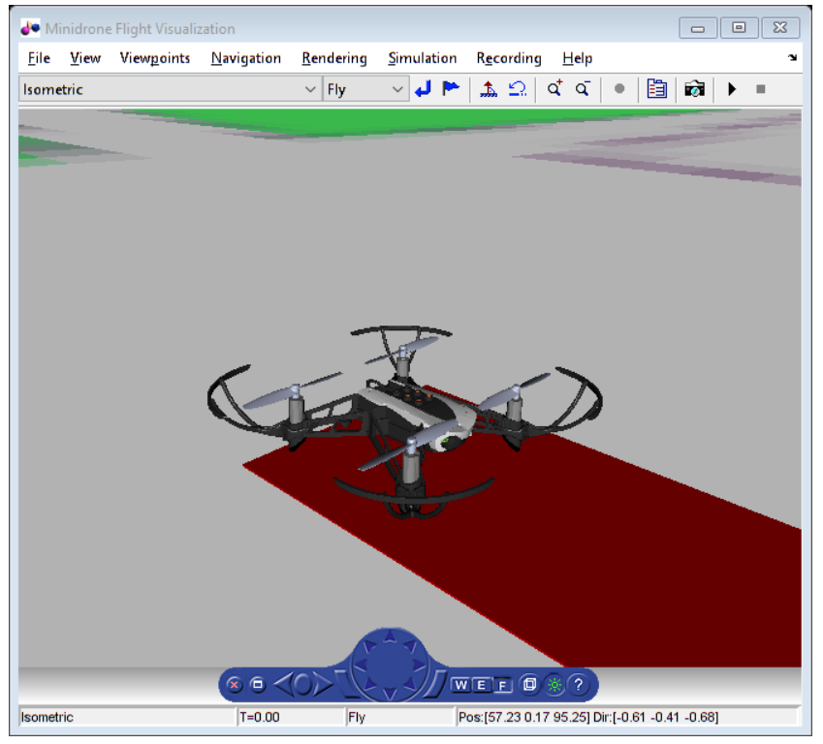
Video Interface of the Parrot Minidrone
Notes:
Explain from where we can obtain the Parrot minidrone toolbox
Run the

Slide 20
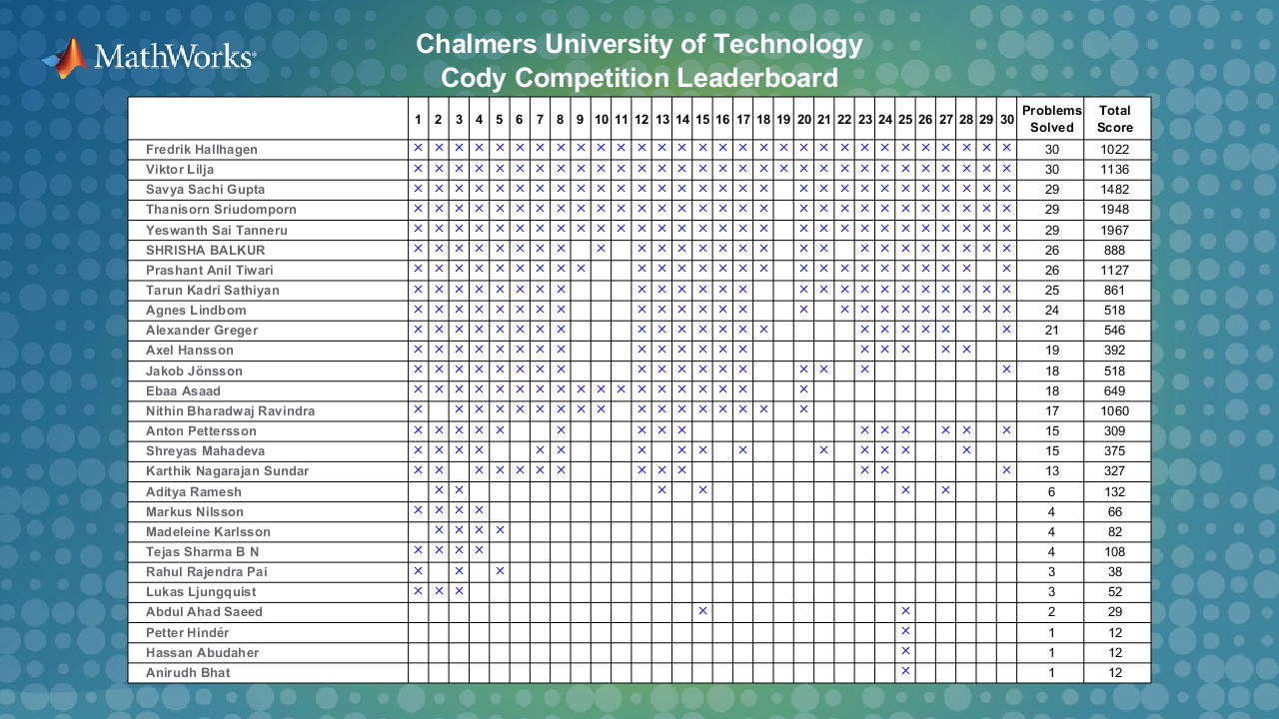
Leaderboard for the Cody Competition

Slide 21
MATLAB Cody Challenge Winners
The top 5 students get an Amazon Gift Card worth 150 SEK.
Fredrik Hallhagen
Viktor Lilja
Savya Sachi Gupta
Thanisorn Sriudomporn
Yaswanth Sai Tenneru
Notes:
Special mention to the last two. Because their scores were extraordinary.

Slide 22

How to get Simulink?
Student at Chalmers are entitled with a free license of MATLAB/Simulink with the student account.
Free toolboxes.
Download MATLAB from https://se.mathworks.com/downloads/
Available on different platforms like Windows, Mac etc.
Instructions to download and install: https://studentfile.portal.chalmers.se/

Slide 23

Want to learn MATLAB and Simulink?
Free access to over 10+ paid courses for Chalmerists
These include
MATLAB for Data Processing and Visualization
MATLAB Fundamentals
MATLAB Programming Techniques
MATLAB for Financial Applications
Machine Learning with MATLAB
Deep Learning with MATLAB
Introduction to Symbolic Math with MATLAB
Solving Nonlinear Equations with MATLAB
Solving Ordinary Differential Equations with MATLAB
Introduction to Linear Algebra with MATLAB
Introduction to Statistical Methods with MATLAB
Sign up to the above courses on https://matlabacademy.mathworks.com/
Complete at least 60% of any courses listed above and get a free MATLAB t-shirt.

Slide 24
Kahoot Time!!!!

Slide 25
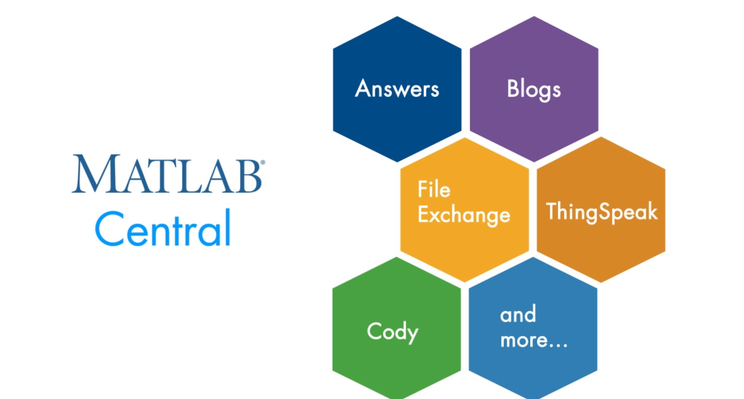
Need help with MATLAB/Simulink?
Join the MATLAB central community
Notes:
-It is a gathering place for MATLAB and Simulink community
-Driven by community and can learn topics like deep learning, AI and IoT
-Answers: what to do in MATLAB?
-File exchange: Repository of applications from MATLAB community. Can download and run the application and modify
-Cody: Interactive text book, solve problems, practice for exams
-Blogs: Showcase MATLAB in real world
Whole point is to learn and have fun doing it.

Slide 26
QUESTIONS??

